Slide 1
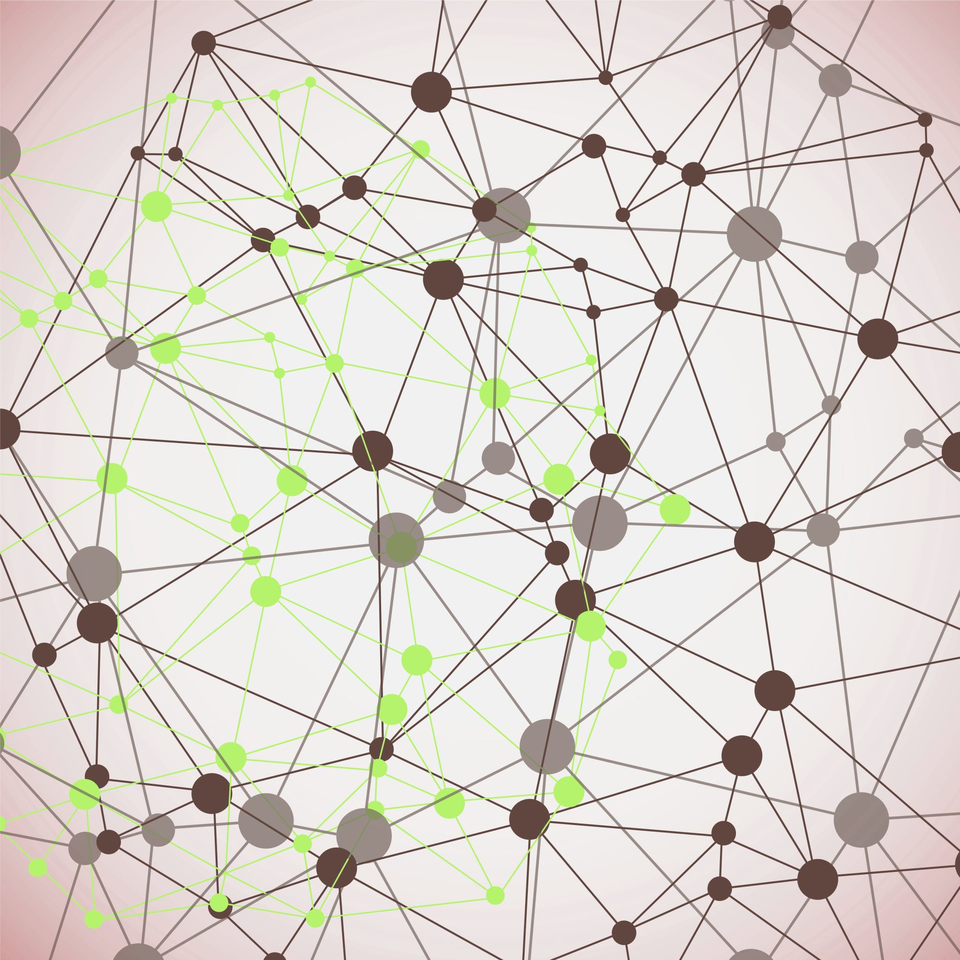
DSP Project
Skin Cancer Classification
By,
Amulya Geereddy
Vivek Kotha
Jeremy Maury
Olanrewaju Olasupo

Slide 2
About Dataset
Skin cancer — the abnormal growth of skin cells — most often develops on skin exposed to the sun. But this common form of cancer can also occur on areas of your skin not ordinarily exposed to sunlight.
The final dataset consists of 10015 dermatoscopic images which can be used as a training set for this project. Cases constitute a cross-section of all key diagnostic categories in the field of pigmented lesions
https://dataverse.harvard.edu/dataset.xhtml?persistentId=doi:10.7910/DVN/DBW86T

Slide 3
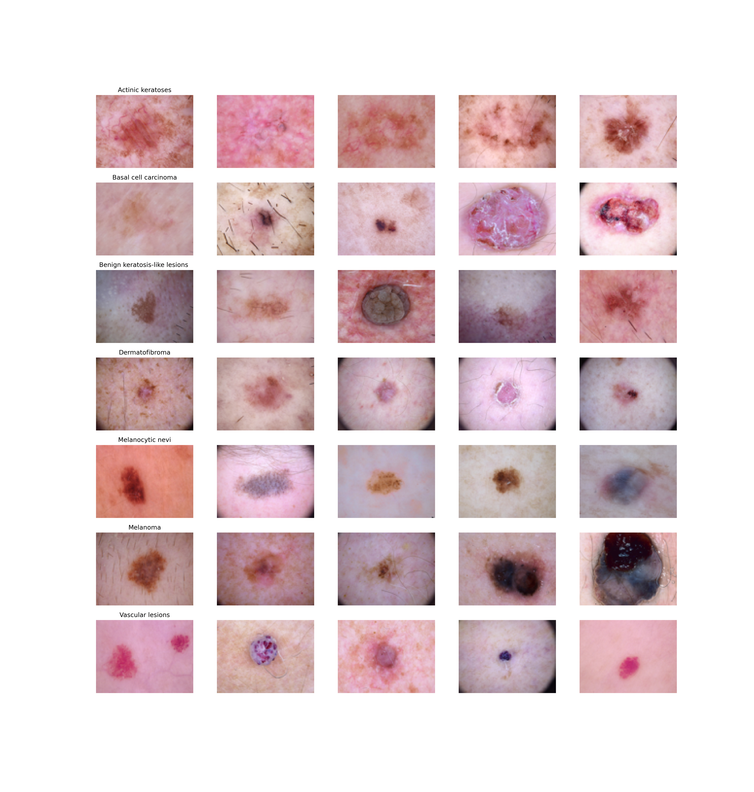
Image Classification
It has 7 different classes of skin cancer : 1. Melanocytic nevi 2. Melanoma 3. Benign keratosis-like lesions 4. Basal cell carcinoma 5. Actinic keratoses 6. Vascular lesions 7. Dermatofibroma

Slide 4
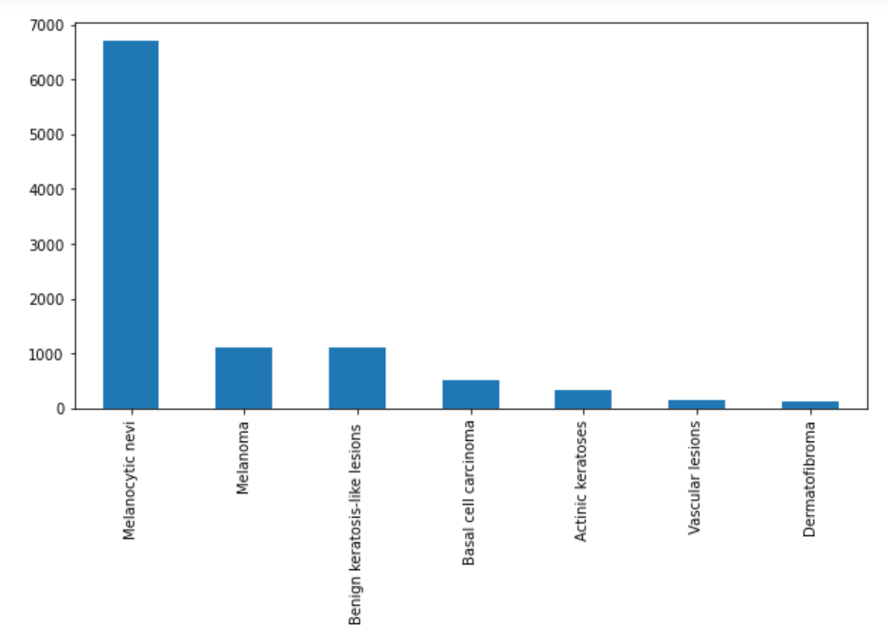
Imbalanced Dataset

Slide 5
Preprocessing the Data
Resizing the data and Converting RGB images to numpy arrays
We converted the image size of all the images from 450x600 x3 into 100x75 for uniformity using PIL Library.
Label Encoding
Labels are 7 different classes of skin cancer types from 0 to 6. We need to encode these labels to one hot vectors
Data Augmentation
In order to avoid over fitting we can make our existing dataset even larger. We have altered the training data with small transformations to reproduce the variations.

Slide 6
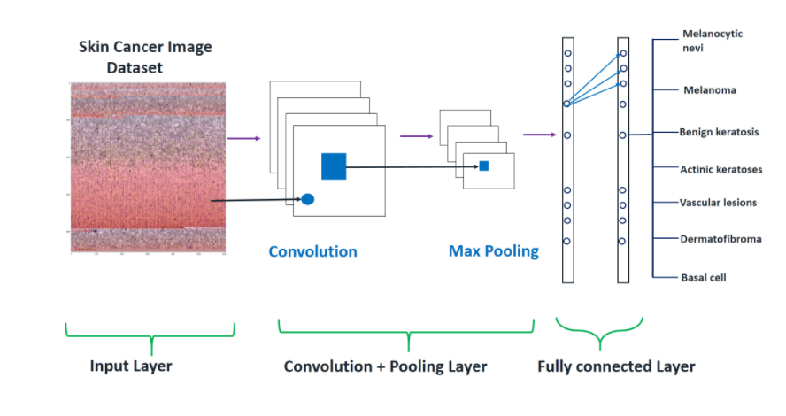
CNN Model Architecture

Slide 7
Things to do
Achieved Accuracy is almost 73 percent as of now.
Usage of resampling techniques besides data augmentation like SMOTE techniques.
Hyper parameter tuning to improve the F1 score of the model.
We are planning to use Streamlit or flask packages to create front-end application for predicting the Input Image.

